Slide 1
The Autonomic
Nervous System

Slide 2
Autonomic Nervous System (ANS)
ANS consists of motor neurons that
  Innervate smooth and cardiac muscle, and glands
  Make adjustments to ensure optimal support for body activities
  Operate via subconscious control
Also called involuntary nervous system or general visceral motor system

Slide 3
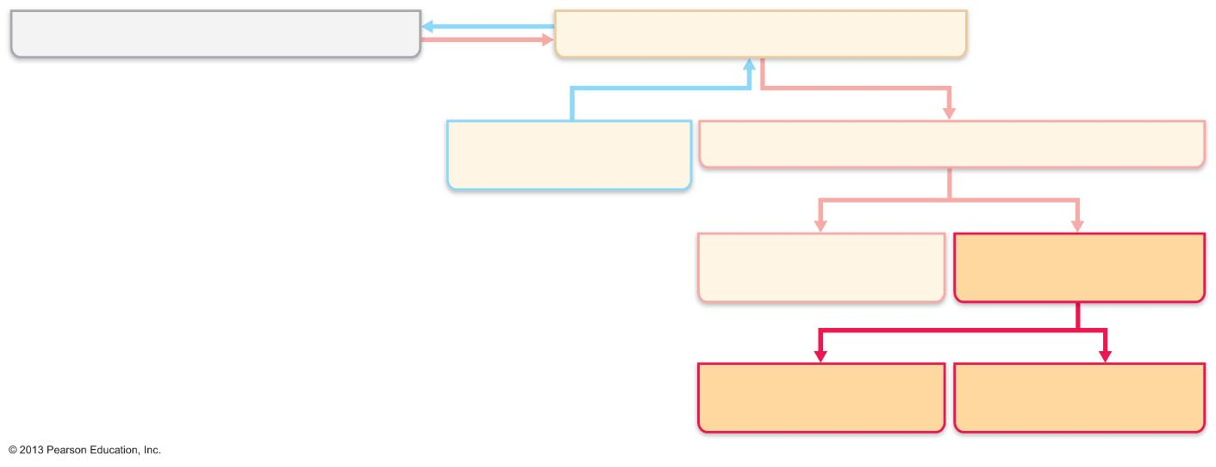
Figure 14.1 Place of the ANS in the structural organization of the nervous system.
Central nervous system (CNS)
Peripheral nervous system (PNS)
Sensory (afferent)
division
Motor (efferent) division
Somatic nervous
system
Autonomic nervous
system (ANS)
Sympathetic
division
Parasympathetic
division

Slide 4
Somatic Versus Autonomic Nervous Systems
Both have motor fibers
Differ in
  Effectors
  Efferent pathways and ganglia
  Target organ responses to neurotransmitters

Slide 5
Effectors
Somatic nervous system
  Skeletal muscles
ANS
  Cardiac muscle
  Smooth muscle
  Glands

Slide 6
Efferent Pathways and Ganglia
Somatic nervous system
  Cell body in CNS; thick, myelinated, group A fiber extends in spinal or cranial nerve to skeletal muscle
ANS pathway uses two-neuron chain
  1. Preganglionic neuron (in CNS) has a thin,
  lightly myelinated preganglionic axon.
  2. Postganglionic (ganglionic) neuron in
  autonomic ganglion outside CNS has
  nonmyelinated postganglionic axon that
  extends to effector organ

Slide 7
Neurotransmitter Effects
Somatic nervous system
  All somatic motor neurons release acetylcholine (ACh)
  Effects always stimulatory
ANS
  Preganglionic fibers release ACh
  Postganglionic fibers release norepinephrine or ACh at effectors
  Effect is either stimulatory or inhibitory,
  depending on type of receptors

Slide 8
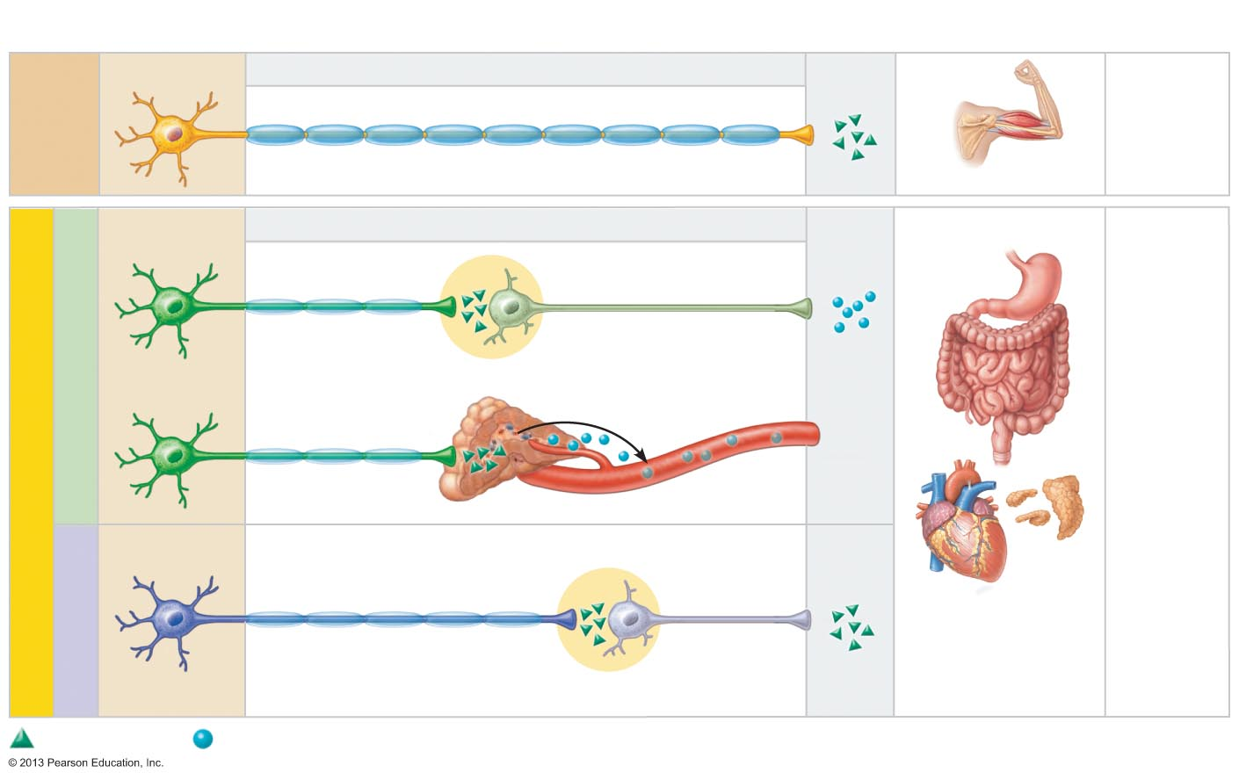
Figure 14.2 Comparison of motor neurons in the somatic and autonomic nervous systems.
Cell bodies in central
nervous system
Peripheral nervous system
Neurotransmitter
at effector
Effector
organs
Effect
Single neuron from CNS to effector organs
SOMATIC
NERVOUS
SYSTEM
ACh
+
Heavily myelinated axon
Stimulatory
Skeletal muscle
Two-neuron chain from CNS to effector organs
ACh
NE
Nonmyelinated
postganglionic axon
SYMPATHETIC
Lightly myelinated
preganglionic axons
Ganglion
Epinephrine and
norepinephrine
+
–
ACh
Stimulatory
or inhibitory,
depending
on neuro-
transmitter
and receptors
on effector
organs
AUTONOMIC NERVOUS SYSTEM
Adrenal medulla
Blood vessel
ACh
ACh
Smooth muscle
(e.g., in gut), glands,
cardiac muscle
PARASYMPATHETIC
Lightly myelinated
preganglionic axon
Nonmyelinated
postganglionic
axon
Ganglion
Acetylcholine (ACh)
Norepinephrine (NE)

Slide 9
Overlap of Somatic and Autonomic Function
Most spinal and many cranial nerves contain both somatic and autonomic fibers
Adaptations usually involve both skeletal muscles and visceral organs

Slide 10
Divisions of the ANS
Sympathetic division
Parasympathetic division
Dual innervation
  ~ All visceral organs served by both divisions, but cause opposite effects
Dynamic antagonism between two divisions maintains homeostasis

Slide 11
Role of the Parasympathetic Division
Promotes maintenance activities and conserves body energy
  Directs digestion, diuresis, defecation
As in person relaxing and reading after a meal
  Blood pressure, heart rate, and respiratory rates are low
  Gastrointestinal tract activity high
  Pupils constricted; lenses accommodated for close vision

Slide 12
Role of the Sympathetic Division
Mobilizes body during activity; "fight-or-flight" system
Exercise, excitement, emergency, embarrassment
  Increased heart rate; dry mouth; cold, sweaty skin; dilated pupils

Slide 13
Role of the Sympathetic Division
During vigorous physical activity
  Shunts blood to skeletal muscles and heart
  Dilates bronchioles
  Causes liver to release glucose

Slide 14
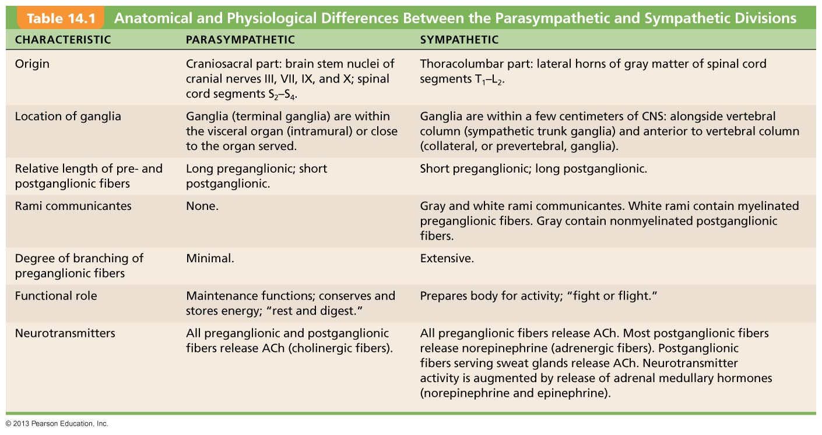
Table 14.1 Anatomical and Physiological Differences Between the Parasympathetic and Sympathetic Divisions

Slide 15
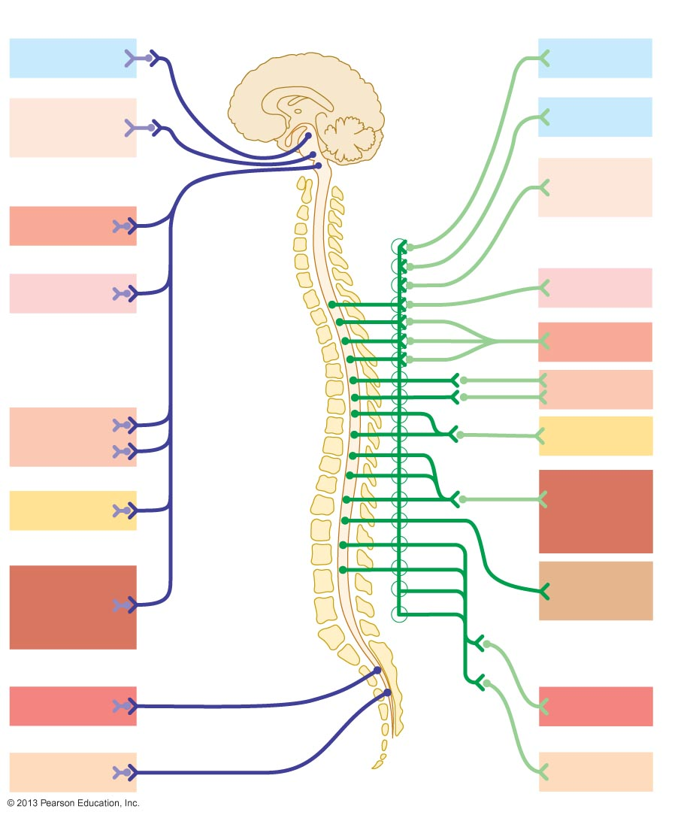
Figure 14.3 The subdivisions of the ANS.
Parasympathetic
Sympathetic
Eye
Brain stem
Eye
Salivary
glands
Skin*
Cranial
Sympathetic
ganglia
Salivary
glands
Heart
Cervical
Lungs
Lungs
T₁
Heart
Stomach
Thoracic
Stomach
Pancreas
Liver
and gall-
bladder
Pancreas
L₁
Liver and
gall-
bladder
Adrenal
gland
Lumbar
Bladder
Bladder
Genitals
Sacral
Genitals

Slide 16
Parasympathetic (Craniosacral) Division
Long preganglionic fibers from brain stem and sacrum
  Extend from CNS almost to target organs
  Synapse with postganglionic neurons in terminal ganglia close to/within target organs
  Short postganglionic fibers synapse with effectors

Slide 17
Cranial Part of Parasympathetic Division
Cell bodies in brain stem
Preganglionic fibers in oculomotor, facial, glossopharyngeal, and vagus nerves
Oculomotor nerves – smooth muscle of eye
Facial nerves – stimulate large glands in head
Glossopharyngeal nerves – parotid salivary glands
Vagus nerves – neck and nerve plexuses for ~ all thoracic and abdominal viscera

Slide 18
Sacral Part of Parasympathetic Division
Serves pelvic organs and distal half of large intestine
From neurons in lateral gray matter of S₂-S₄
Axons travel in ventral root of spinal nerves
Synapse with
  Ganglia in pelvic floor
  Intramural ganglia in walls of distal half of large intestine, urinary bladder, ureters, and reproductive organs

Slide 19
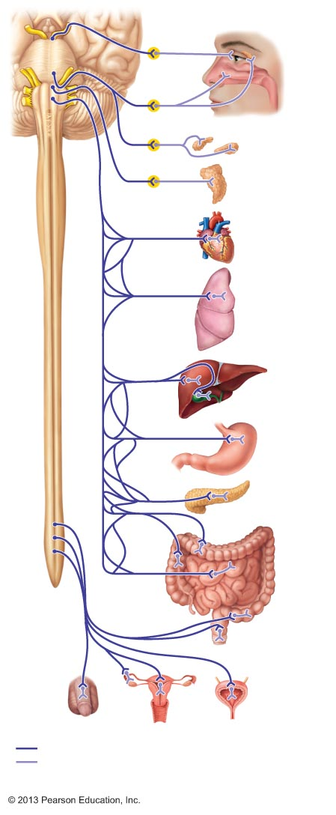
Figure 14.4 Parasympathetic division of the ANS.
CN III
Ciliary
ganglion
Eye
Lacrimal
gland
CN VII
Pterygopalatine
ganglion
Nasal
mucosa
CN IX
CN X
Submandibular
ganglion
Submandibular
and sublingual
glands
Otic ganglion
Parotid gland
Cardiac and
pulmonary
plexuses
Heart
Lung
Liver and
gallbladder
Celiac
plexus
Stomach
Pancreas
S₂
Large
intestine
S₄
Pelvic
splanchnic
nerves
Small
intestine
Inferior
hypogastric
plexus
Rectum
Urinary
bladder
and ureters
Genitalia (penis, clitoris, and vagina)
Preganglionic
CN
Postganglionic
S
Cranial nerve
Sacral nerve

Slide 20
Sympathetic (Thoracolumbar) Division
Preganglionic neurons are in spinal cord segments T₁ – L₂
  Form lateral horns of spinal cord
Preganglionic fibers pass through white rami communicantes and enter sympathetic trunk (chain or paravertebral) ganglia

Slide 21
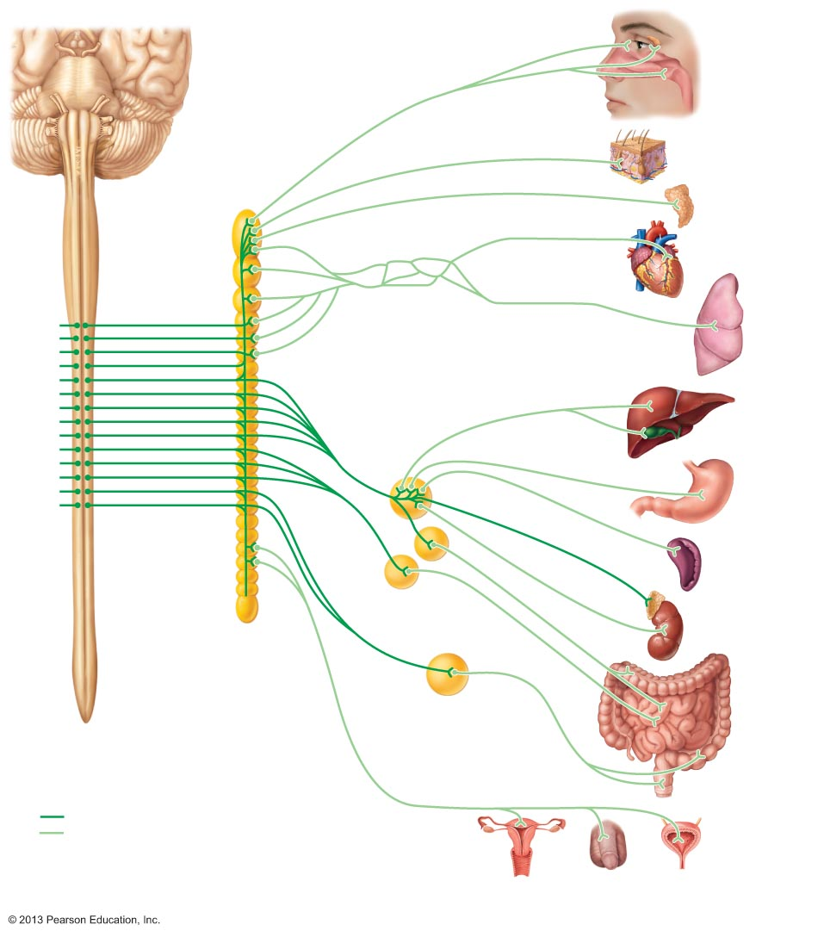
Figure 14.6 Sympathetic division of the ANS.
Eye
Lacrimal gland
Pons
Nasal mucosa
Sympathetic trunk
(chain) ganglia
Blood vessels;
skin (arrector pili
muscles and
sweat glands)
Superior
cervical
ganglion
Middle
cervical
ganglion
Salivary glands
Heart
Inferior
cervical
ganglion
Cardiac and
pulmonary
plexuses
Lung
T₁
Greater splanchnic nerve
Lesser splanchnic nerve
Celiac ganglion
Liver and
gallbladder
L₂
Stomach
White rami
communicantes
Superior
mesenteric
ganglion
Spleen
Inferior
mesenteric
ganglion
Adrenal medulla
Sacral
splanchnic
nerves
Kidney
Lumbar
splanchnic nerves
Small
intestine
Large
intestine
Rectum
Preganglionic
Postganglionic
Genitalia (uterus, vagina, and
penis) and urinary bladder

Slide 22
Sympathetic Trunks and Pathways
Paravertebral ganglia vary in size, position, and number
There are 23 paravertebral ganglia in the sympathetic trunk (chain)
  3 cervical
  11 thoracic
  4 lumbar
  4 sacral
  1 coccygeal

Slide 23
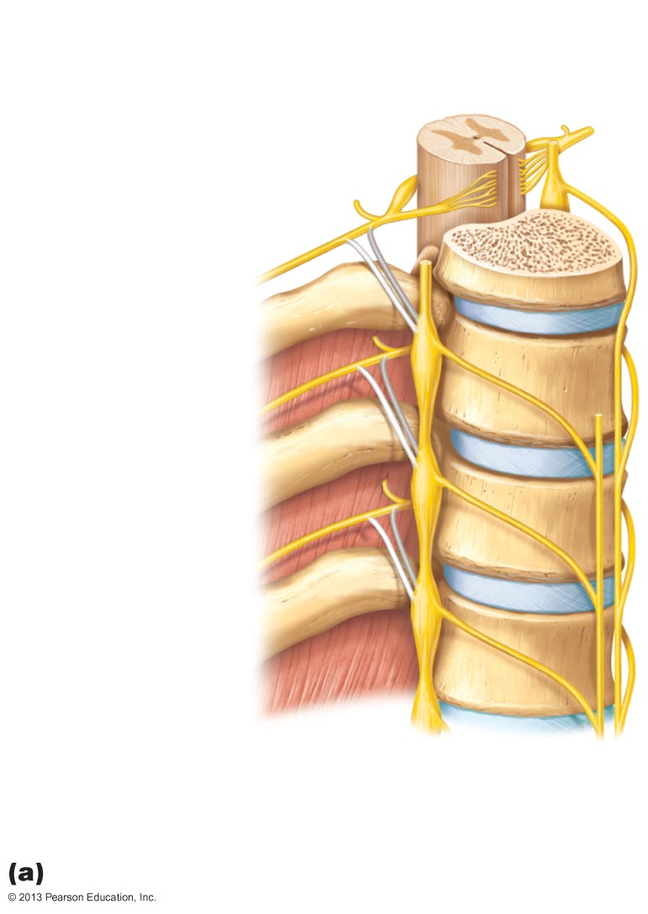
Figure 14.5a Sympathetic trunks and pathways.
Spinal cord
Dorsal root
Ventral root
Rib
Sympathetic
trunk ganglion
Sympathetic
trunk
Ventral ramus
of spinal nerve
Gray ramus
communicans
White ramus
communicans
Thoracic
splanchnic nerves
Location of the sympathetic trunk

Slide 24
Sympathetic Trunks and Pathways
Upon entering sympathetic trunk ganglion short preganglionic fiber may
  Synapse with ganglionic neuron in same trunk ganglion
  Ascend or descend sympathetic trunk to synapse in another trunk ganglion
  Pass through trunk ganglion and emerge without synapsing (only in abdomen and pelvis)

Slide 25
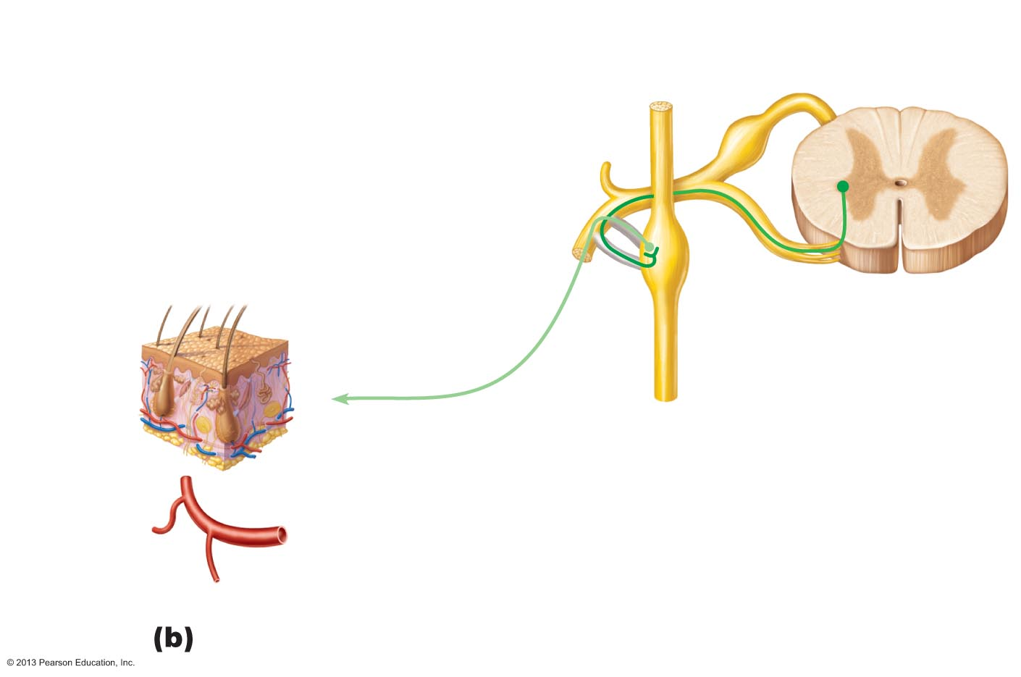
Figure 14.5b Sympathetic trunks and pathways. (1 of 3)
Lateral horn (visceral
motor zone)
Dorsal root
Dorsal root ganglion
Dorsal ramus of
spinal nerve
Ventral ramus of
spinal nerve
Skin (arrector
pili muscles
and sweat
glands)
Gray ramus
communicans
Ventral root
White ramus
communicans
Sympathetic
trunk ganglion
Sympathetic trunk
Effectors
1
Synapse at the same level
Blood vessels
Three pathways of sympathetic innervation

Slide 26
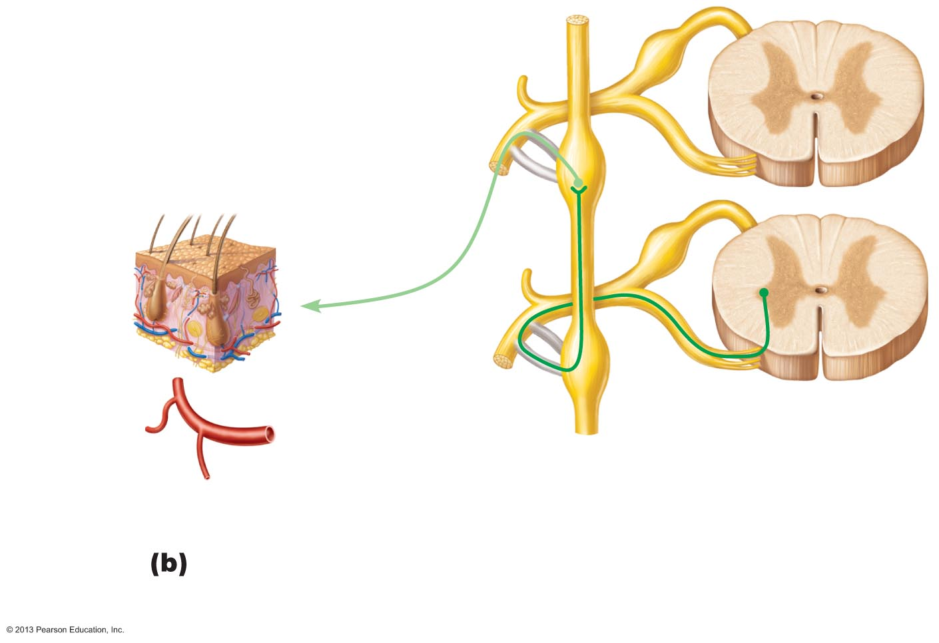
Figure 14.5b Sympathetic trunks and pathways. (2 of 3)
Skin (arrector
pili muscles
and sweat
glands)
Effectors
Blood vessels
2
Synapse at a higher or lower level
Three pathways of sympathetic innervation

Slide 27
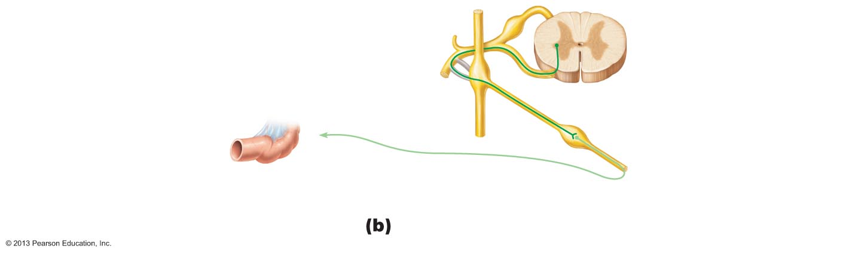
Figure 14.5b Sympathetic trunks and pathways. (3 of 3)
Splanchnic
nerve
Collateral ganglion
(such as the celiac)
Effector
Abdominal
organs
(e.g., intestine)
3
Synapse in a distant collateral ganglion anterior to the vertebral column
Three pathways of sympathetic innervation

Slide 28
Pathways with Synapses in Trunk Ganglia
Postganglionic axons enter ventral rami via gray rami communicantes
These fibers innervate
  Sweat glands
  Arrector pili muscles
  Vascular smooth muscle

Slide 29
Pathways to the Head
Fibers emerge from T₁ – T₄ and synapse in the superior cervical ganglion
These fibers
  Innervate skin and blood vessels of the head
  Stimulate dilator muscles of the iris
  Inhibit nasal and salivary glands
  Innervate smooth muscle of upper eyelid
  Branch to the heart

Slide 30
Pathways to the Thorax
Preganglionic fibers emerge from T₁ – T₆ and synapse in cervical trunk ganglia
Postganglionic fibers emerge from middle and inferior cervical ganglia and enter nerves C₄ – C₈
These fibers innervate
  Heart via the cardiac plexus
  Thyroid gland and the skin
  Lungs and esophagus

Slide 31
Pathways with Synapses in Collateral Ganglia
Most fibers from T₅ – L₂ synapse in collateral ganglia
They form thoracic, lumbar, and sacral splanchnic nerves
Their ganglia include the celiac and the superior and inferior mesenteric

Slide 32
Pathways to the Abdomen
Preganglionic fibers from T₅ – L₂ travel through thoracic splanchnic nerves
Synapses occur in celiac and superior mesenteric ganglia
Postganglionic fibers serve the stomach, intestines, liver, spleen, and kidneys

Slide 33
Pathways to the Pelvis
Preganglionic fibers from T₁₀ – L₂ travel via lumbar and sacral splanchnic nerves
Synapses occur in the inferior mesenteric and hypogastric ganglia
Postganglionic fibers serve the distal half of the large intestine, the urinary bladder, and the reproductive organs
Primarily inhibit activity of muscles and glands in abdominopelvic visceral organs

Slide 34
Pathways with Synapses in the Adrenal Medulla
Some preganglionic fibers pass directly to adrenal medulla without synapsing
Upon stimulation, medullary cells secrete norepinephrine and epinephrine into blood
Sympathetic ganglia and adrenal medulla arise from same tissue
  Adrenal medulla is "misplaced" sympathetic ganglion

Slide 35
Visceral Reflexes
Visceral reflex arcs have same components as somatic reflex arcs
  But visceral reflex arc has two neurons in motor pathway
Visceral pain afferents travel along same pathways as somatic pain fibers, contributing to phenomenon of referred pain

Slide 36
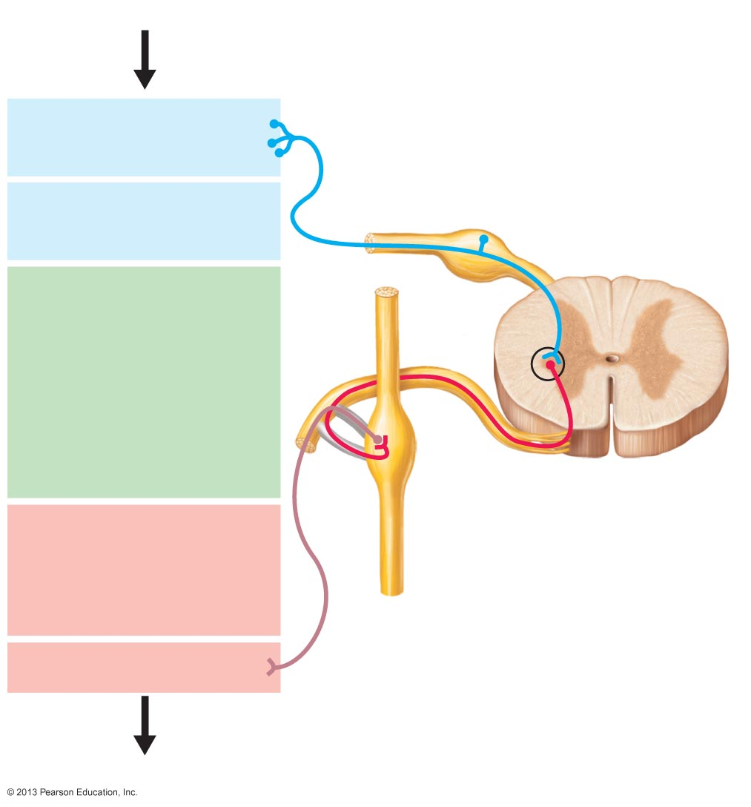
Figure 14.7 Visceral reflexes.
Stimulus
1
Receptor in viscera
Dorsal root ganglion
2
Spinal cord
Visceral sensory
neuron
3
Integration center
• May be preganglionic
neuron (as shown)
• May be a dorsal horn
interneuron
• May be within walls
of gastrointestinal
tract
Autonomic ganglion
4
Motor neuron
(two-neuron chain)
• Preganglionic neuron
• Postganglionic neuron
5
Visceral effector
Response

Slide 37
Neurotransmitters
Cholinergic fibers release neurotransmitter ACh
  All ANS preganglionic axons
  All parasympathetic postganglionic axons at effector synapse
Adrenergic fibers release neurotransmitter NE
  Most sympathetic postganglionic axons
  Exception: sympathetic postganglionic fibers secrete ACh at sweat glands

Slide 38
Figure 14.2 Comparison of motor neurons in the somatic and autonomic nervous systems.
Cell bodies in central
nervous system
Peripheral nervous system
Neurotransmitter
at effector
Effector
organs
Effect
Single neuron from CNS to effector organs
SOMATIC
NERVOUS
SYSTEM
ACh
+
Heavily myelinated axon
Stimulatory
Skeletal muscle
Two-neuron chain from CNS to effector organs
ACh
NE
Nonmyelinated
postganglionic axon
SYMPATHETIC
Lightly myelinated
preganglionic axons
Ganglion
Epinephrine and
norepinephrine
+
–
ACh
Stimulatory
or inhibitory,
depending
on neuro-
transmitter
and receptors
on effector
organs
AUTONOMIC NERVOUS SYSTEM
Adrenal medulla
Blood vessel
ACh
ACh
Smooth muscle
(e.g., in gut), glands,
cardiac muscle
PARASYMPATHETIC
Lightly myelinated
preganglionic axon
Nonmyelinated
postganglionic
axon
Ganglion
Acetylcholine (ACh)
Norepinephrine (NE)

Slide 39
Receptors for Neurotransmitters
Cholinergic receptors for ACh
Adrenergic receptors for NE

Slide 40
Cholinergic Receptors
Two types of receptors bind ACh
  Nicotinic
  Muscarinic
Named after drugs that bind to them and mimic ACh effects

Slide 41
Nicotinic Receptors
Found on
  Sarcolemma of skeletal muscle cells
  (Chapter 9) at NMJ
  All postganglionic neurons (sympathetic and parasympathetic)
  Hormone-producing cells of adrenal medulla
Effect of ACh at nicotinic receptors is always stimulatory
  Opens ion channels, depolarizing postsynaptic cell

Slide 42
Muscarinic Receptors
Found on
  All effector cells stimulated by postganglionic cholinergic fibers
Effect of ACh at muscarinic receptors
  Can be either inhibitory or excitatory
  Depends on receptor type of target organ

Slide 43
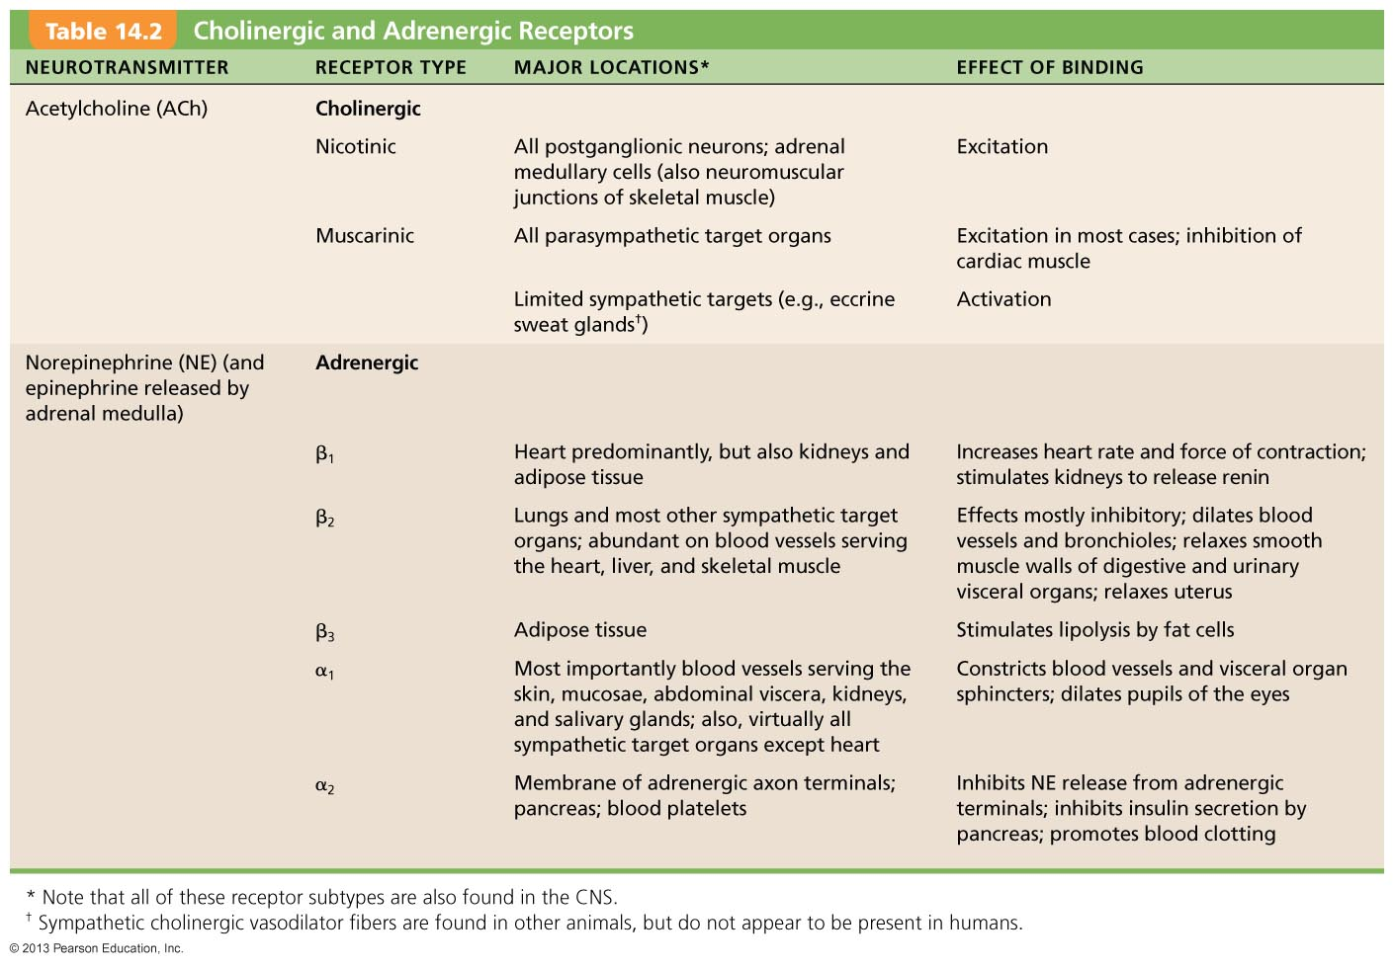
Table 14.2 Cholinergic and Adrenergic Receptors

Slide 44
Adrenergic Receptors
Two major classes
  Alpha (α) (subtypes α₁, α₂)
  Beta (β) (subtypes β₁, β₂ , β₃)
Effects of NE depend on which subclass of receptor predominates on target organ

Slide 45
Effects of Drugs
Atropine
  Anticholinergic; blocks muscarinic ACh receptors
  Used to prevent salivation during surgery, and to dilate pupils for examination
Neostigmine
  Inhibits acetylcholinesterase that breaks down ACh
  Used to treat myasthenia gravis

Slide 46
Effects of Drugs
Over-the-counter drugs for colds, allergies, and nasal congestion
  Stimulate α-adrenergic receptors
Beta-blockers
  Drugs that attach to β₂ receptors to dilate lung bronchioles in asthmatics; other uses

Slide 47
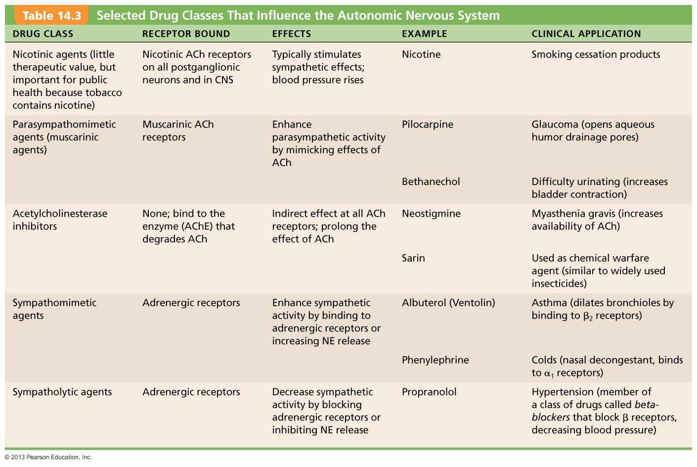
Table 14.3 Selected Drug Classes That Influence the Autonomic Nervous System

Slide 48
Interactions of the Autonomic Divisions
Most visceral organs have dual innervation
Dynamic antagonism allows for precise control of visceral activity
  Sympathetic division increases heart and respiratory rates, and inhibits digestion and elimination
  Parasympathetic division decreases heart and respiratory rates, and allows for digestion and discarding of wastes

Slide 49
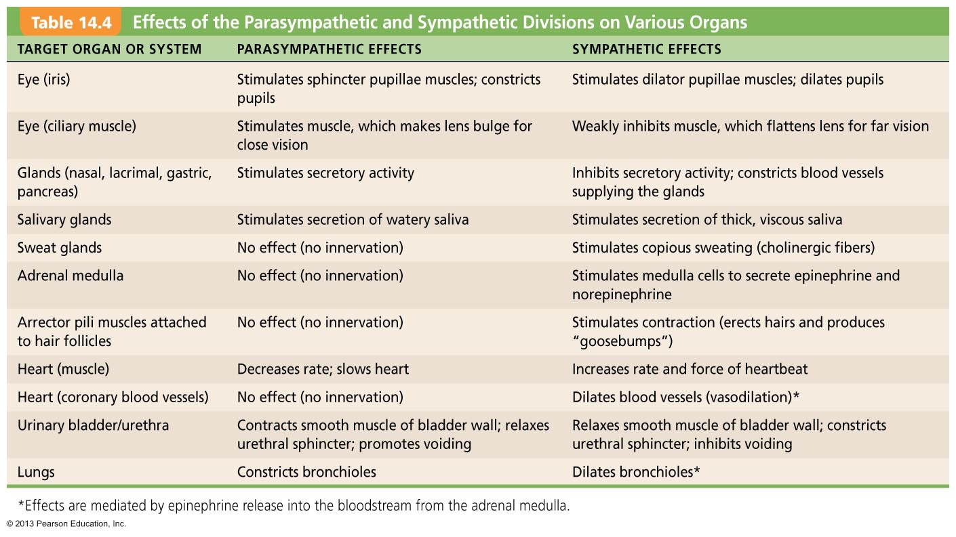
Table 14.4 Effects of the Parasympathetic and Sympathetic Divisions on Various Organs (1 of 2)

Slide 50
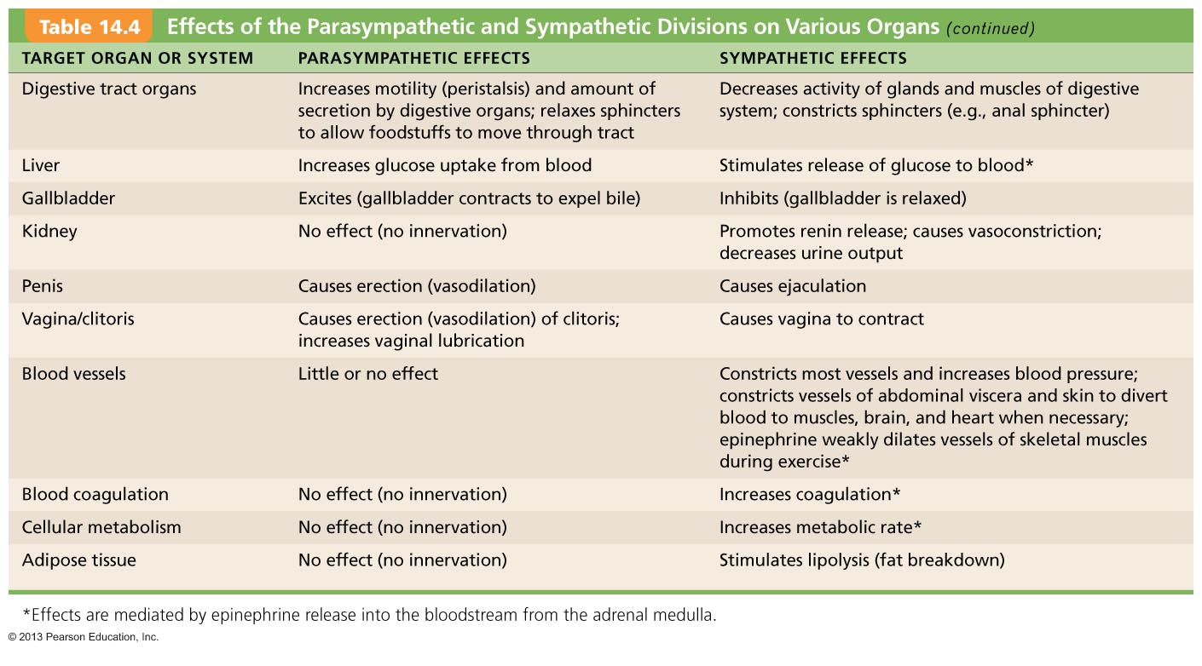
Table 14.4 Effects of the Parasympathetic and Sympathetic Divisions on Various Organs (2 of 2)

Slide 51
Sympathetic Tone
Sympathetic division controls blood pressure, even at rest
Vascular system ~ entirely innervated by sympathetic fibers
Sympathetic tone (vasomotor tone)
  Keeps blood vessels in continual state of partial constriction

Slide 52
Sympathetic Tone
Sympathetic fibers fire more rapidly to constrict blood vessels and cause blood pressure to rise
Sympathetic fibers fire less rapidly to prompt vessels to dilate to decrease blood pressure
Alpha-blocker drugs interfere with vasomotor fibers
  Used to treat hypertension

Slide 53
Parasympathetic Tone
Parasympathetic division normally dominates heart, smooth muscle of digestive and urinary tract organs, activate most glands except for adrenal and sweat glands
  Slows the heart
  Dictates normal activity levels of digestive and urinary tracts
The sympathetic division can override these effects during times of stress
Drugs that block parasympathetic responses increase heart rate and cause fecal and urinary retention

Slide 54
Cooperative Effects
Best seen in control of external genitalia
Parasympathetic fibers cause vasodilation; are responsible for erection of penis or clitoris
Sympathetic fibers cause ejaculation of semen in males and reflex contraction of a female's vagina

Slide 55
Unique Roles of the Sympathetic Division
Adrenal medulla, sweat glands, arrector pili muscles, kidneys, and most blood vessels receive only sympathetic fibers
Sympathetic division controls
  Thermoregulatory responses to heat
  Release of renin from kidneys
  Metabolic effects
    Increases metabolic rates of cells
    Raises blood glucose levels
    Mobilizes fats for use as fuels

Slide 56
Localized Versus Diffuse Effects
Parasympathetic division: short-lived, highly localized control over effectors
  ACh quickly destroyed by acetylcholinesterase
Sympathetic division: longer-lasting, bodywide effects
  NE inactivated more slowly than ACh
  NE and epinephrine hormones from adrenal medulla prolong effects

Slide 57
Control of ANS Function
Hypothalamus—main integrative center of ANS activity
Subconscious cerebral input via limbic system structures on hypothalamic centers
Other controls come from cerebral cortex, reticular formation, and spinal cord

Slide 58
Hypothalamic Controls
Control may be direct or indirect (through reticular system)
Centers of hypothalamus control
  Heart activity and blood pressure
  Body temperature, water balance, and endocrine activity
  Emotional stages (rage, pleasure) and biological drives (hunger, thirst, sex)
  Reactions to fear and "fight-or-flight" system

Slide 59
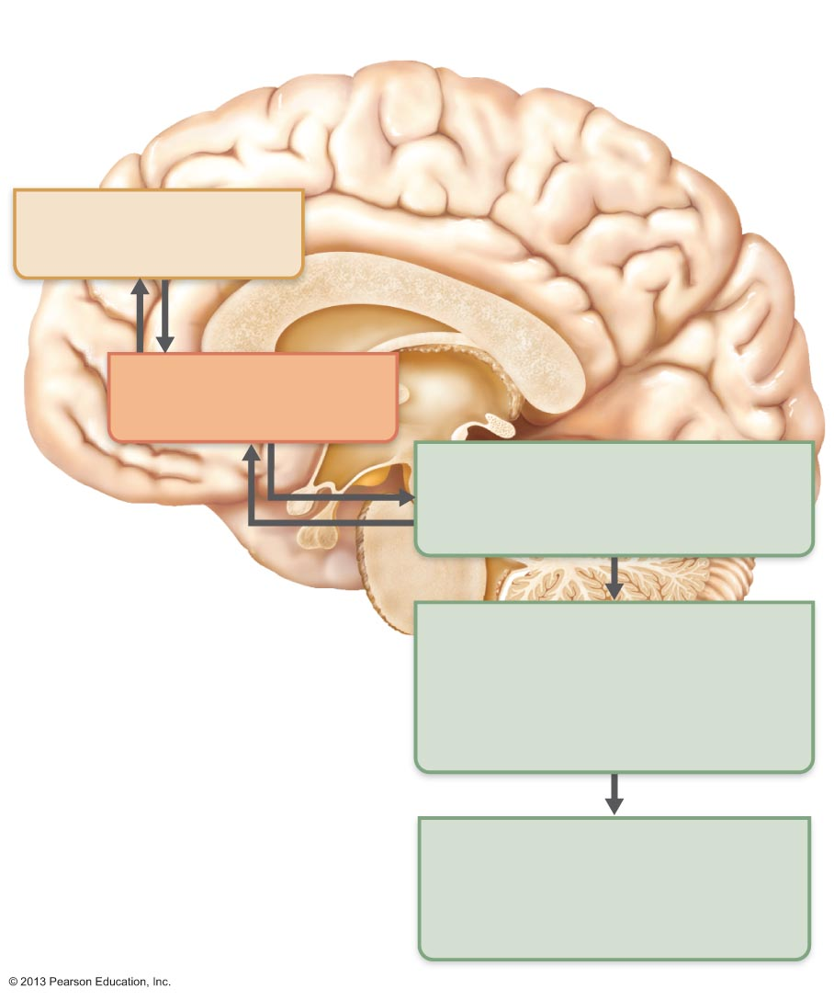
Figure 14.8 Levels of ANS control.
Communication at
subconscious level
Cerebral cortex
(frontal lobe)
Limbic system
(emotional input)
Hypothalamus
The “boss”: Overall
integration of ANS
Brain stem
(reticular formation, etc.)
Regulates pupil size, heart,
blood pressure, airflow,
salivation, etc.
Spinal cord
Reflexes for urination,
defecation, erection,
and ejaculation

Slide 60
Cortical Controls
Connections of hypothalamus to limbic lobe allow cortical influence on ANS
Voluntary cortical control of visceral activities is possible
  Biofeedback
    Awareness of physiological conditions with goal of consciously influencing them
    Biofeedback training allows some to control migraines and manage stress

Slide 61
Homeostatic Imbalances of the ANS
Hypertension (high blood pressure)
  Overactive sympathetic vasoconstrictor response to stress
  Treated with adrenergic receptor - blocking drugs
Raynaud's disease
  Exaggerated vasoconstriction in fingers and toes
    Pale, then cyanotic and painful
    Treated with vasodilators

Slide 62
Homeostatic Imbalances of the ANS
Autonomic dysreflexia
  Uncontrolled activation of autonomic neurons in quadriplegics and those with spinal cord injuries above T₆
  Blood pressure skyrockets
  Life-threatening

Slide 63
Developmental Aspects of the ANS
ANS preganglionic neurons from neural tube
ANS structures in PNS from neural crest
Nerve growth factor and signaling chemicals aid axonal pathfinding to target organs
During youth, ANS impairments usually due to injury
ANS efficiency declines in old age, partially due to structural changes at preganglionic axon terminals

Slide 64
Developmental Aspects of the ANS
Effects of age on ANS
  Constipation
  Dry eyes
  Frequent eye infections
  Orthostatic hypotension
    Low blood pressure after position change
    Pressure receptors less responsive to blood pressure changes
    Cardiovascular centers fail to maintain healthy blood pressure

